Slide 2

We're True To Form, a London-based experience design agency.
We thought we'd share a simplified version of our deck template for presenting UX ideas, research, rough ideas, and interactive workshops for the Pitch community.
Feel free to adapt, steal or better 😁

Slide 3
Table of contents
01
Turning adversity into opportunity
02
Training knowledge transfer
03
The devil's in the data
04
Making connections & bridging gaps

Slide 4
Our process
This can be an intro text to explain the purpose of this slide
01
02
03
04
HUNTING
Searching for Pain
EXPERIENCE
Living that pain
UNDERSTAND
Connecting the dots
EXPLORE
This is us today!
Stumptown organic tousled, live-edge vegan adaptogen cliche farm-to-table bushwick glossier pinterest.
Selvage man braid humblebrag pour-over listicle taxidermy jianbing master cleanse gentrify shoreditch. Typewriter mumbleco.
Poke keffiyeh XOXO post-ironic pour-over williamsburg intelligentsia raw denim roof party austin.
Stumptown organic tousled, live-edge vegan adaptogen cliche farm-to-table bushwick glossier pinterest.

Slide 5
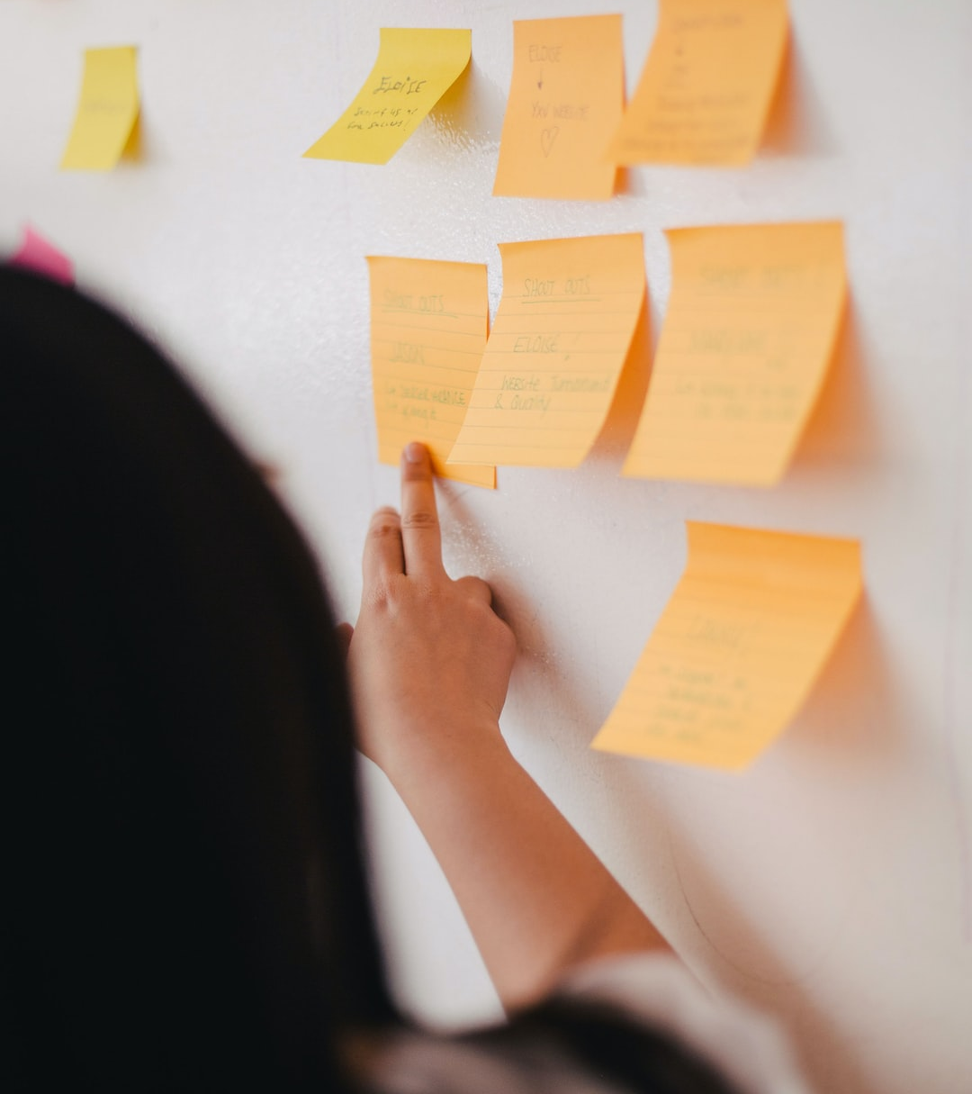
Sample project
Acme Client
Create a long-term strategy by building real foundational UX workflows, which in time will be baked into all projects.
Our direct collaboration with your designers, engineers, project managers and account managers will lead to a deeper human-first approach to all product work leading to stronger client relationships, happier teams and “better” product.
Image caption

Slide 6
Product roadmap
Visual roadmap for strategic and long-range planning at a super high-level
JAN
FEB
MAR
APR
MAY
JUN
JUL
AUG
SEP
OCT
NOV
DEC
Event Horizon
Blocker
Onsite Research @ HQ - NYC
Remote Interviews & A/B testing
Build React Prototype

Slide 7
Voting results
Dot-voting participants vote on their chosen options using a limited number of votes.
Idea A
Idea C
42% · 16 Votes
42% · 16 Votes
Idea B
Idea D
42% · 16 Votes
42% · 16 Votes

Slide 9
